Slide 1


Breast Cancer
A look into incidence and mortality and a breast cancer detection model
Fernanda Vommaro
Misha Baton
Umang

Slide 2
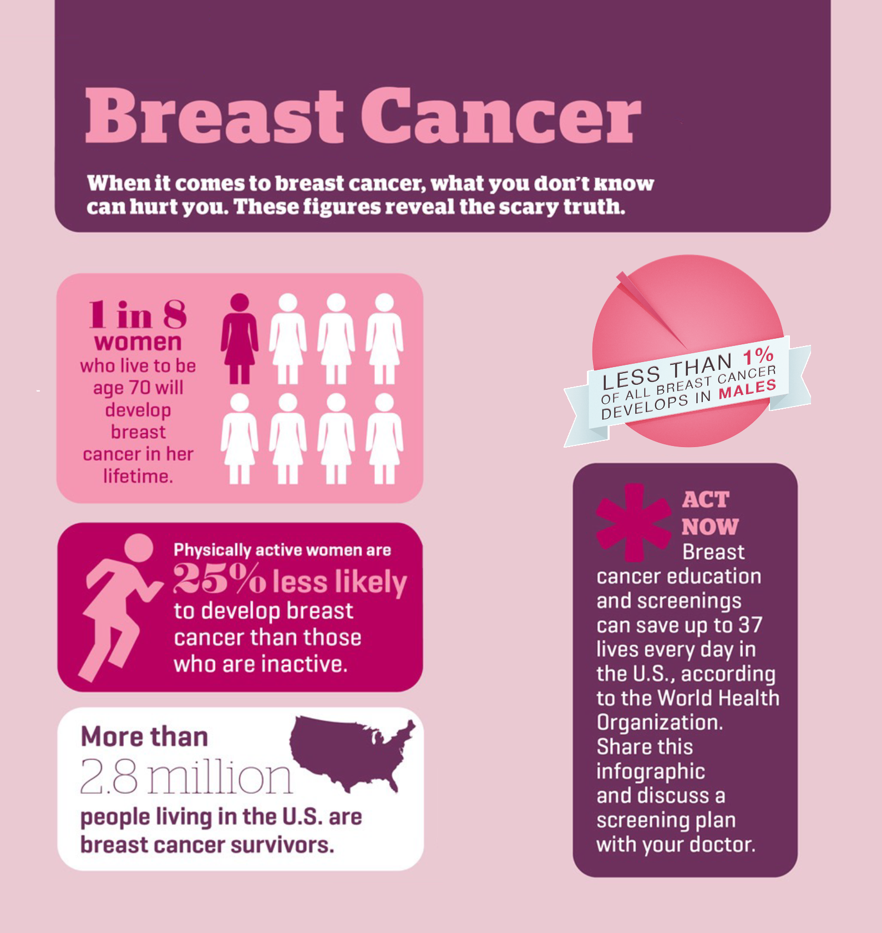

Motivation

Slide 3



Dataset

Slide 4




Methodology
Detection Tree Classifier
Random Forests
Logistic Regression
Linear Regression
Vizualization
Clean and process data

Slide 5
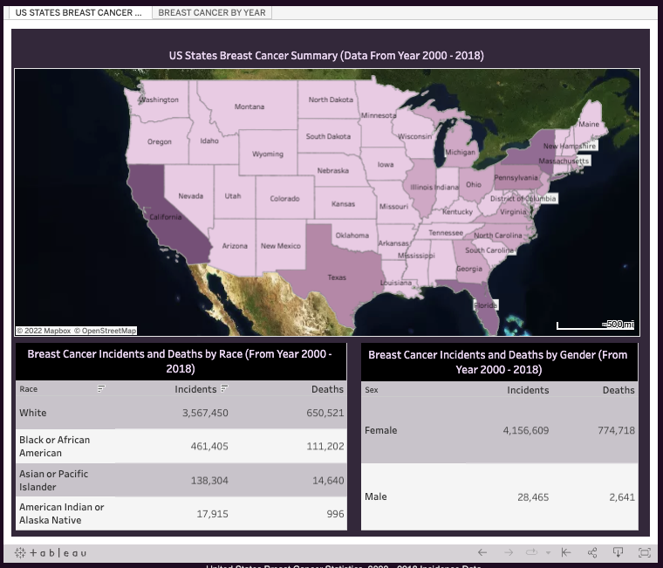
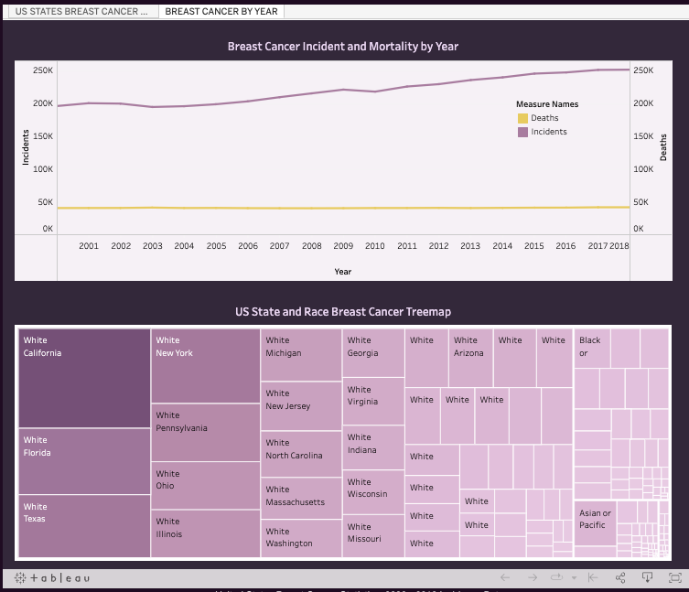
Visualization

Slide 6
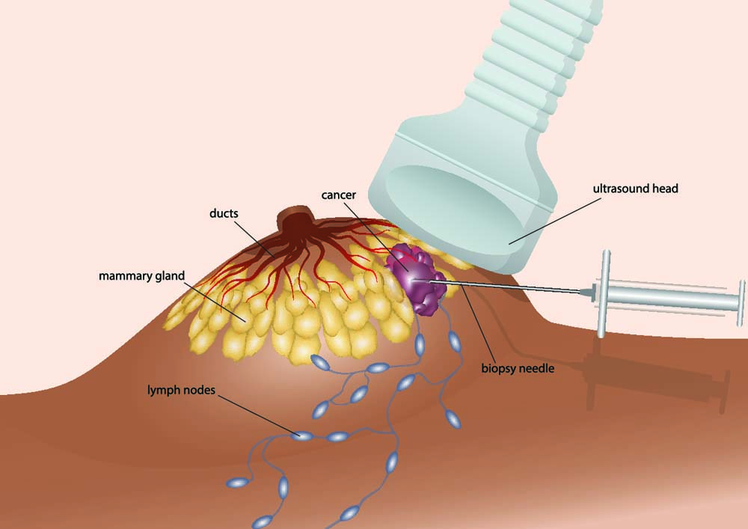
Breast Cancer Detection
DATASET:
University of Wisconsin
Fine Needle Aspirate (FNA)
Characteristics of the cell nuclei

Slide 7
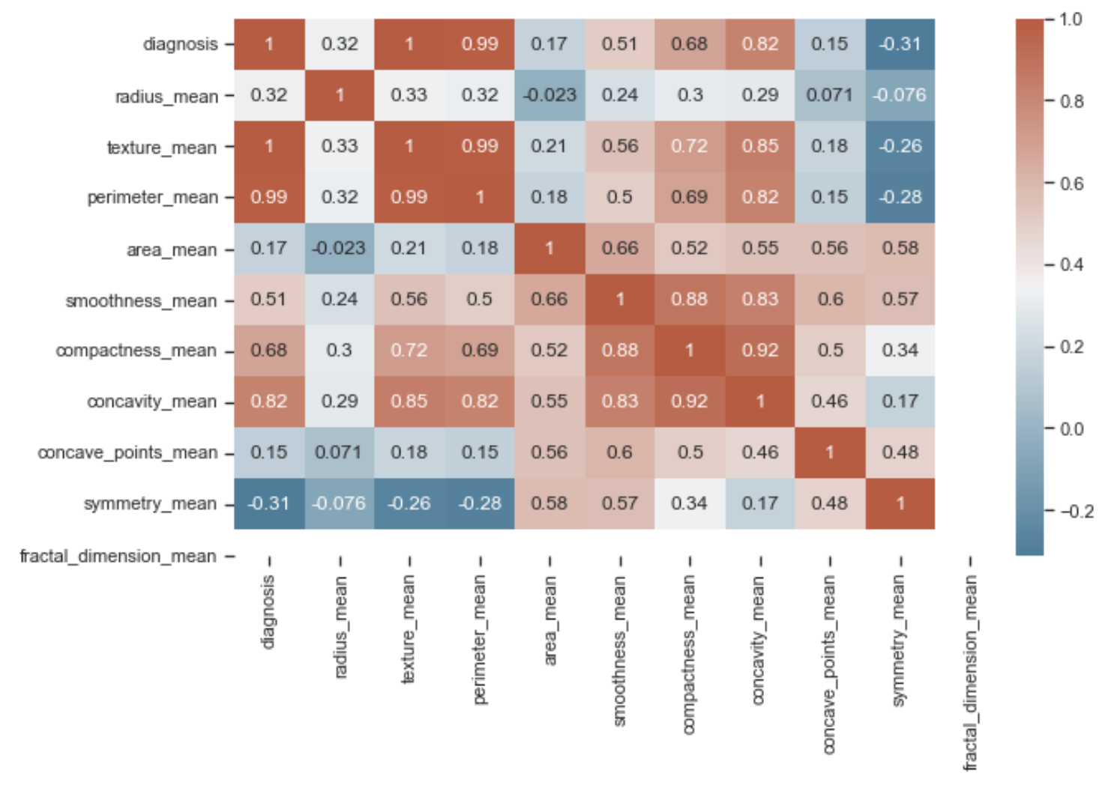
Breast Cancer Detection
Correlation Heatmap Matrix

Slide 8
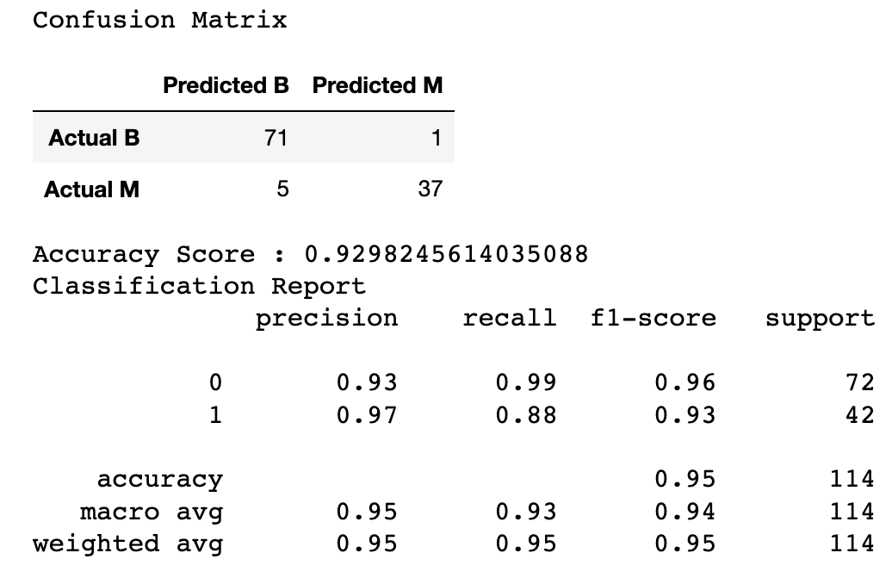

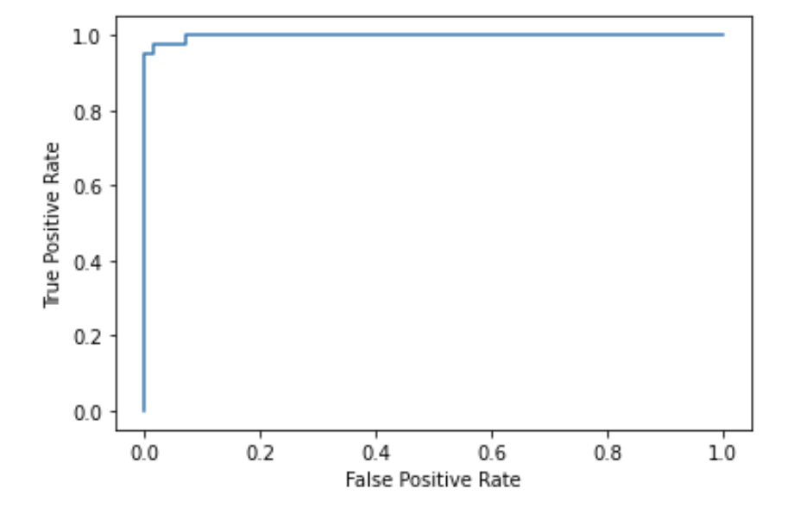
Breast Cancer Detection
Random Forests

Slide 9
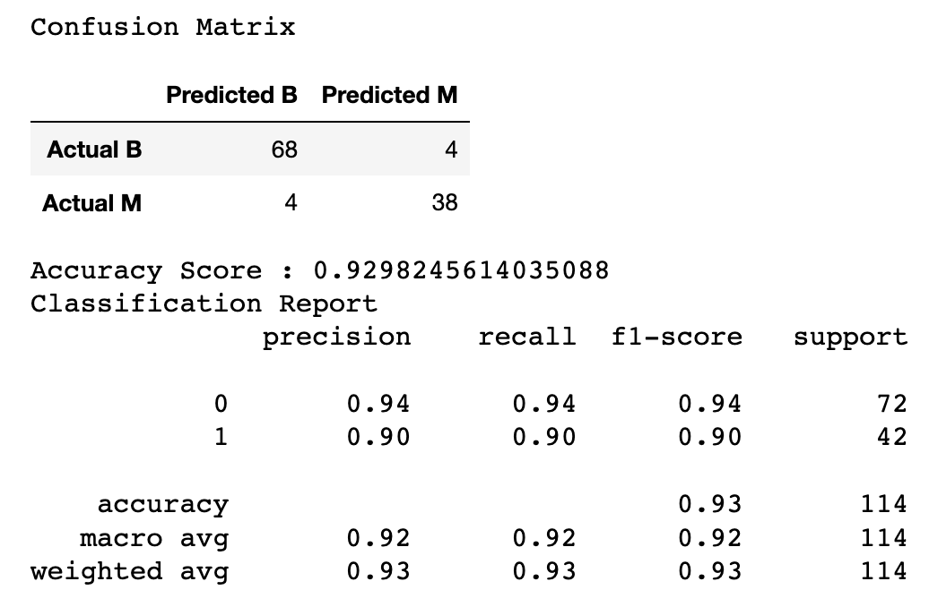
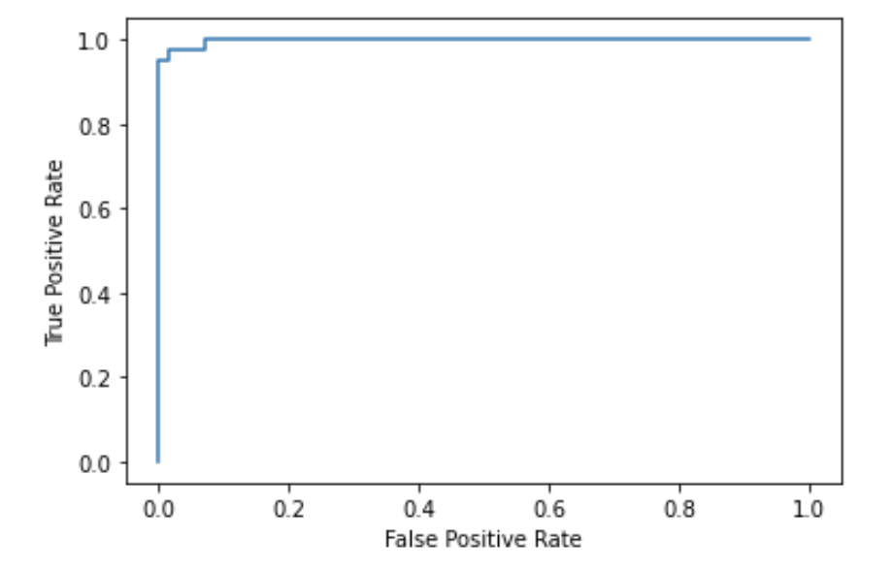
Breast Cancer Detection
Decision Tree Classifier

Slide 10
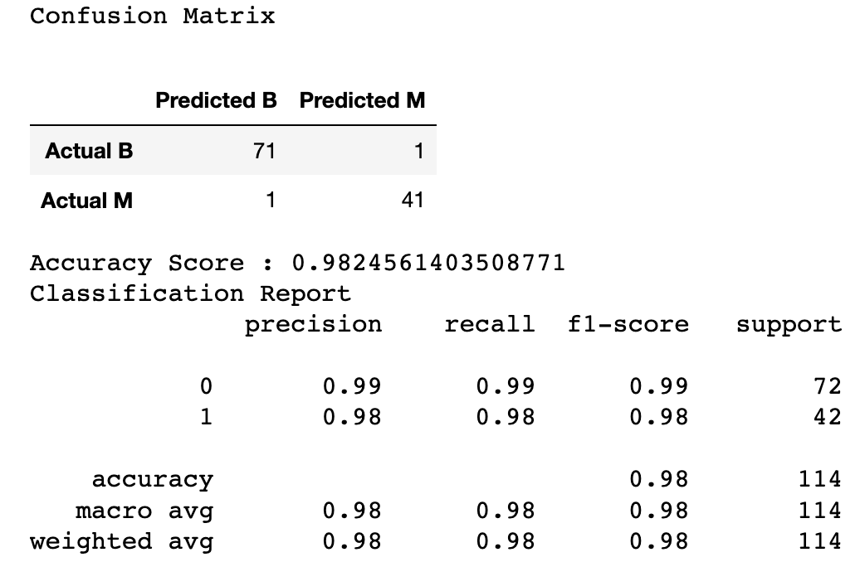

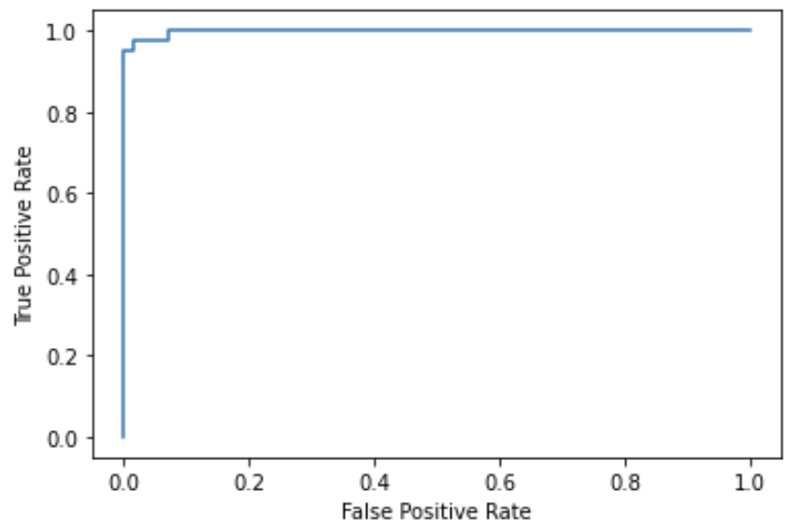
Breast Cancer Detection
Logistic Regression

Slide 11

Limitations
Statistical Visualization
Statistical dataset with categorical variables
Recent data not easily available
Breast Cancer Detection
Not having patient demographic data.
Still 1 false negative.

Slide 12

Strenghts
Statistical Vizualization
Statistical dataset with categorical variables
Model can be used for other cancers or other diseases
Breast Cancer Detection
No missing values in the dataset.
Mostly numerical data.
Potential application with patient triage.

Slide 13

Future work
Statistical Vizualization
Add data from 2019 to present
Add interactive linear models to the webpage
Include age-grouped data
Expand globally
Breast Cancer Detection
Retrain the model with a larger dataset.
Build a tool where doctors can provide inputs and see the results for their patients.
Expand the model for other types of cancer.

Slide 14

Any questions

